Slide 1



Antimicrobial Resistance Profiles and Detection of mecA, blaCTX-M-1, and blaSHV genes in Bacteria among Diabetic Foot Ulcer Patients from Kisumu County, Kenya
Name: Silas O. Awuor
Qualification: CMLT, DMLT, B.Sc., MSc, PhD-Medical Microbiology
Specialty: Medical Microbiology
Institution: JOOTRH-Kisumu
IPNET-K Conference 2025

Slide 2
Introduction
Effective management of Diabetic foot ulcers (DFU) requires timely treatment of infections with appropriate antibiotics based on culture and susceptibility results.
However, challenges in diagnostic testing persist and consequently, data on prevalent bacteria, their antimicrobial resistance profiles and genes remains scanty.
This study profiled the prevalent bacteria in Diabetic foot infection (DFI), their antimicrobial susceptibility patterns, and associated resistance genes.

Slide 3
Methodology
A multi-center cross sectional study was conducted from March 2025-July 2025, involving 117 patients with DFU, attending selected referral hospitals within the seven sub-county in Kisumu County.
Wound swabs were aseptically collected and placed in Stuart transport medium, then pre-enriched prior to inoculation onto Blood, MacConkey and Chocolate Agar to isolate aerobic microorganisms.
Bacteria identification was based on colony morphology, Gram stain and conventional biochemical tests.
Antibiotic susceptibility testing was performed using Kirby-Bauer disk diffusion method.
Methicillin-resistant Staphylococcus aureus (MRSA) and extended-spectrum beta-lactamase-producing Enterobacterales (ESBL-PE) were identified phenotypically.
mecA gene in selected MRSA, and blaCTX-M-1 and blaSHV-1 in ESBL-PE were detected using Uniplex PCR and electrophoresed using 1.5% agarose gel.

Slide 4
RESULT & DISCUSSION
Among the 117 DFU patients, 105 (89.7%) yielded bacterial growth (for diabetic foot infection (DFI)).
Among patients whose samples yielded bacterial growth, 80 (76.2%) had monomicrobial infections while 25 (23.8%) had poly microbial infections.
Of those with poly-microbial infections, 15 (14.3%), 6 (5.7%) and 4 (3.8%) had two, three and four bacteria isolated from the same patient, respectively.
A total of 144 bacterial isolates were obtained from 105 patients that had DFI.

Slide 5
Table 1: Bacterial profile on Diabetic Foot ulcers of patients from the different sub-counties
KEY: Where: 1 is Muhoroni sub-county, 2 is Nyando SC, 3 is Nyakach SC, 4 is Kisumu West SC, 5 is Kisumu Central SC, 6 is Kisumu East SC and 7 is Seme SC.

Slide 6
Table 2a: Resistance patterns of the prevalent Gram negative bacteria on DFU to commonly used Antibiotic
IPNET-K Conference 2025

Slide 7
Table 2b: Resistance patterns of the prevalent Gram positive bacteria on DFU to commonly used Antibiotic
IPNET-K Conference 2025

Slide 8
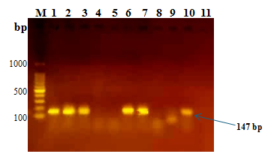
Characterization of mecA genes from Staphylococcus aureus.
Nine (9) of the S. aureus isolates that showed multi drug resistance (MDR) including phenotypic resistance to cefoxitin antibiotic were subjected to uniplex PCR for detection of mecA genes.
Approximately, 147 base pair (bp) amplicon size was obtained for mecA genes.
Out of the nine MDR S. aureus isolates analyzed for mecA genes, five (56%) isolates (KC14-sa, KC10a-sa, KC08-sa, KC16-sa, and KC11b-sa) were positive as shown in Figure 1
KEY: Where lane; M is DNA ladder (100 bp to 1000 bp), 1 is KC14-sa, 2 is KC10a-sa, 3 is KC08-sa, 4 is KC07-sa, 5 is KC04-sa, 6 is KC16-sa, 7 is KC11b-sa, 8 is KC19-sa, 9 is KC15-sa, 10 is Positive control (S. aureus ATCC 33591) and 11 is a Non template control

Slide 9
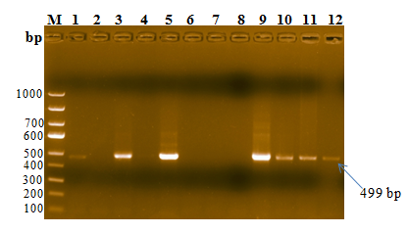
Characterization of β-Lactamase genes from selected MDR Gram-negative bacteria
Ten (10) Gram-negative isolates including 2 E. coli, 5 Klebsiella, 1 Pseudomonas and 2 Proteus spp, that exhibited multidrug resistance, resistance to Imipenem inclusive, were subjected to uniplex PCR for detection of TEM, KPC, blaCTX-M-1 and blaSHV genes.
All isolates were negative for TEM and KPC genes.
Approximately, 499 base pair (bp) amplicon size was obtained for blaCTX-M-1 gene and of the 10 isolates analyzed, six (60%) isolates (KC17EC, KC13Kleb, KC14Kleb, 10-KC18Ps, KC20 Pro and 12-KC06Pro) were positive for blaCTX-M-1 gene as shown in Figure 2
KEY: Where: M is DNA ladder (100 bp to 1000 bp), 1 is KC17EC, 2 is KC10EC, 3 is Positive control (E. coli NCTC 13353), 4 is Non template control, 5 is KC13Kleb, 6 is KC15Kleb, 7 is KC17kleb, 8 is KC26Kleb, 9 is KC14Kleb), 10 is HM18Ps), 11 is KC20 Pro and 12 is KC06Pro.
IPNET-K Conference 2025

Slide 10
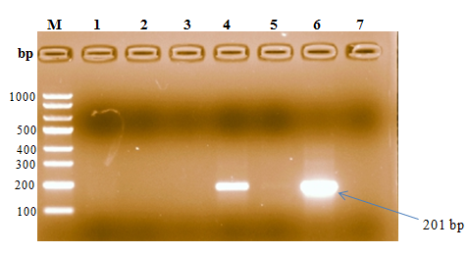
Approximately, 201 base pair (bp) amplicon size was obtained for blaSHV genes.
Out of the five isolates analyzed, only one (20%) isolate (KC14Kleb) was also positive for blaSHV genes as shown in Figure 3 below.
There was presence of mixed genes blaCTX-M-1 and blaSHV genes in sample KD14Kleb.
KEY: Where: M is DNA ladder (100 bp to 1000 bp), 1 is KC17EC, 2 is KC13Kleb, 3 is KC18Ps, 4 is Positive control (Klebsiella pneumoniae NCTC 13368); 5 is Non template control, 6 is KC14Kleb and 7 is KC06Pro.
IPNET-K Conference 2025

Slide 11
CONCLUSION
The study underscores the critical need for informed treatment strategies in diabetic foot infections, given the high prevalence of multidrug-resistant bacteria and the detection of key resistance genes such as mecA, blaCTX-M-1, and blaSHV.
Routine culture and sensitivity testing, guided by current CLSI guidelines, is essential to optimize antibiotic therapy.
Furthermore, exploring alternative therapies, such as phage therapy, and implementing continuous surveillance and coordinated infection control measures are crucial to mitigate the spread of resistant pathogens and improve patient outcomes.
REFERENCE
https://scholar.google.com/citations?user=Yly-yVoAAAAJ&hl=en
Awuor, S. O., Omwenga, E. O., Daud, I. I., & Eliud N. W. (2025). Phage therapy: A new Frontier for Diabetic Foot Ulcer Infections in Kenya. Plos one Health.

Slide 12



THANKS ALL
ONGOING STUDY: Antimicrobial Resistance Profiling and Efficacy Validation of Lytic Bacteriophages Against Selected Pathogens Isolated From Diabetic Foot Ulcers In Kisumu County, Kenya

